Slide 1

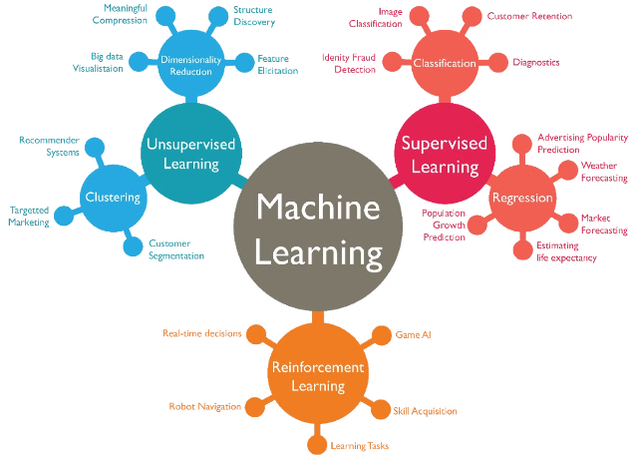
Machine Learning Algorithms
.By : Febin Francis

Slide 2

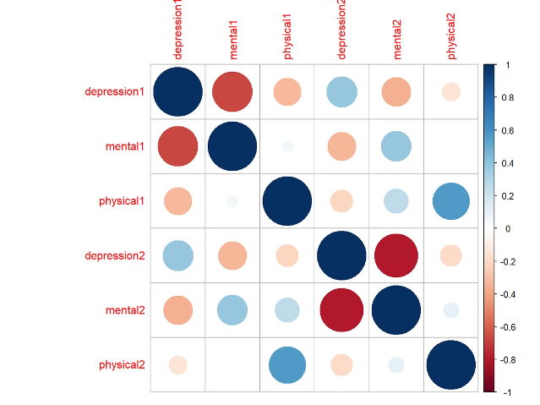
Correlation Matrix Analysis
SLNO and Candidate Ref
0.898788
Candidate Ref and SLNO
0.898788
Highly correlated features (correlation > 0.70) are identified. Actions to take include removing one of the correlated features, using Principal Component Analysis (PCA), or applying regularization techniques.

Slide 3

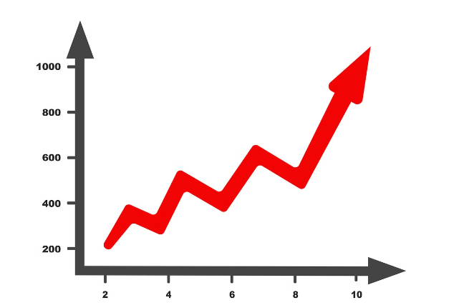
LOB\_Hike\_Offered Feature
Variation in Hike Across LOBs
Examines whether the percentage hike offered differs significantly across various Lines of Business.
Impact of LOB on Compensation
Assesses if the LOB a candidate is joining influences the percentage hike offered.
Grouping and Segmentation
Groups data based on the combination of LOB and hike offered to find patterns.

Slide 4
Feature Selection for Model Building
Numeric Features
Categorical Features
Duration to accept the offer
DOJ extended (Yes/No)
Notice period
Joining bonus (Yes/No)
Percentage hike expected/offered
Gender (Male/Female)
Percent difference CTC
Candidate relocate actual (Yes/No)
REX (in years)
Status (Yes/No)
Age
Offered band (E0/E1/E2/E3)
Candidate source (Employee referral/Agency/Direct)
LOB (Line of Business)
Location

Slide 5

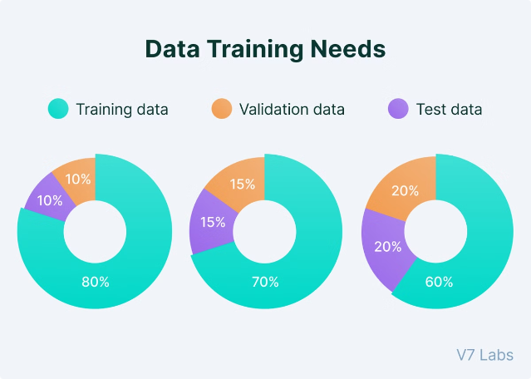
Data Splitting
The data is split into training and test sets, with 80% for training and 20% for testing.

Slide 6

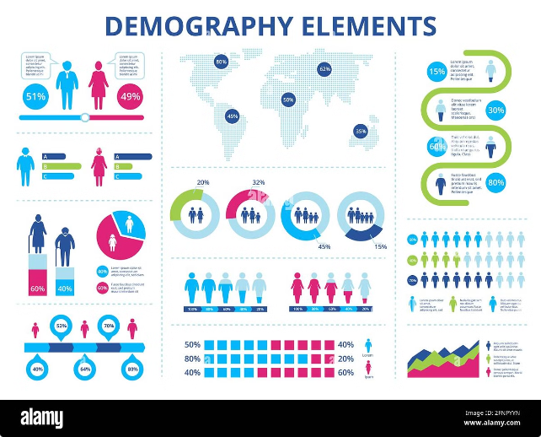
Model with Gender and Age as Predictors
1
Gender
The p-value for Gender is 0.073, indicating marginal significance.
2
Age
The p-value for Age is 0.000, indicating statistical significance.
3
Model Performance
The model achieves an accuracy of 0.81, correctly predicting 81% of the outcomes.

Slide 7

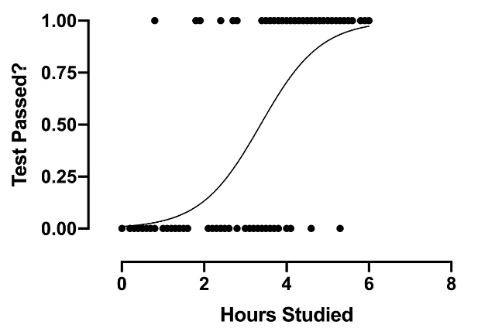
Statsmodel.api Model for Predicting Not Joining
The model predicts the probability of Not Joining using Gender and Age as predictors. Age is statistically significant, while Gender is marginally significant. The model achieves an accuracy of 0.81, but the AUC-ROC score is 0.5459, indicating poor discrimination between classes.

Slide 8

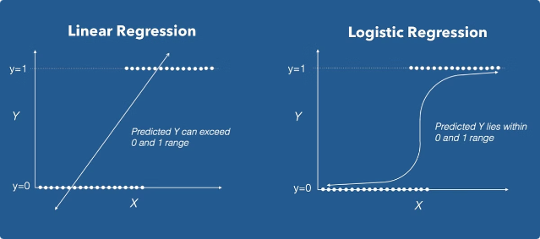
Statsmodel.formula.api Model for Predicting Not Joining
The model built with statsmodels.formula.api uses Gender and Age as predictors. Age is significant, while Gender is marginally significant. The model performs similarly to the previous model, with the same accuracy and AUC-ROC score.

Slide 9

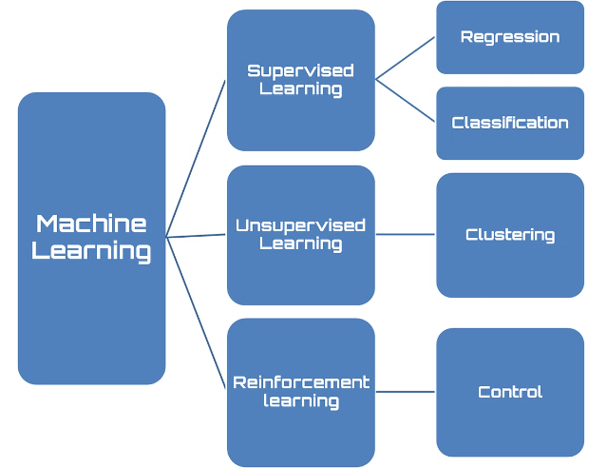
Sklearn Model for Predicting Not Joining
The sklearn model produces similar performance metrics to the models built with statsmodels, indicating consistent results across different implementations. The model struggles to predict the minority class (Joining) due to class imbalance.

Slide 10

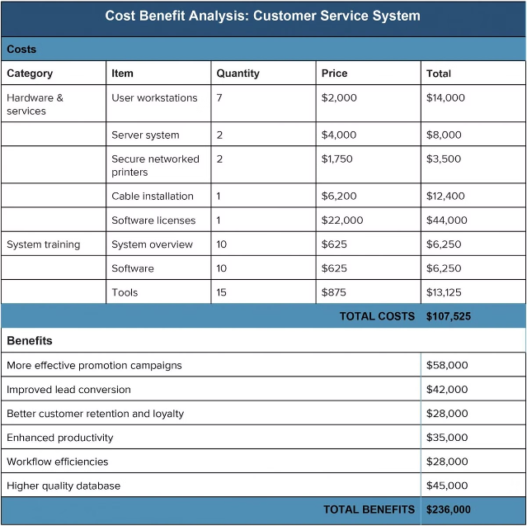
Fine-Tuning Cut-Off Value with Cost of Misclassification
The cut-off value is adjusted to maximize the number of Not Joining cases classified correctly. The model prioritizes identifying class 1 cases (high recall for class 1) but at the expense of precision and overall accuracy.

